Slide 1
Supervised and Unsupervised Learning
What AI can Do or Can’t Do?

Slide 2
How A Machine Learns?

Slide 3
How a Machine Learns?
Learn Mapping Between Input and Output
Can a machine learn on its own ?
Types of Learning
Supervised (Human Intervention Required in training)
Un-Supervised (No Human Intervention in training)
Reinforcement Learning (Continuous Training with user feedback)

Slide 4
Supervised Learning
In training, Human intervention required
Training Data set has features (input data) and labels
Training Dataset requires labels / expert opinion
Example Training Dataset:
Employee Data
satisfaction_level (1-5)
number of projects
average_montly_hours
promotion (Y/N)
salary
Attrition(left job) (Y/N)
Mapping of Input and Labels
Training from Expert Opinion / Labels
Data Patterns
Input
Machine
Output

Slide 5
Un-Supervised Learning
In training, NO Human intervention required
Only Data is Provided for training No Labels / Expert Opinions
Machine only groups similar patterns together
Can Identify non regular / Outlier Patterns
Can also be used to compress the input / de-noise the input
Training from ONLY Data
Data Grouping
Example Training Dataset:
Customer Data
Custid
date
location
total_bill
Data Patterns
Input
Machine
Output

Slide 6
How to Improve Performance of ML model?
OR How to solve Confusing Examples in Supervised / unsupervised Learning ?
Solution:
Add more samples
Add complex features / columns / variables

Slide 7
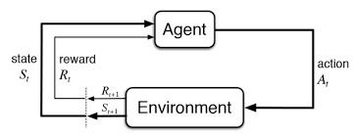
Reinforcement Learning
Intelligent Agent in an environment takes decisions and learns from them based on feedback
Exploration Vs Exploitation
Its continuous learning process

Slide 8
Supervised Learning | Un-Supervised Learning
Human intervention required | No human intervention required
High efficiency | Low efficiency
99% products use Supervised Learning | 1% products use un-supervised learning

Slide 9
What AI/ML/DL can do and can’t Do today?

Slide 10
AI Can Do EASILY (as of) TODAY!
Learn Mapping between input and output
Whatever Human can decide with 1 sec of thought
Example:
Recognizing a regular visitor
Sentiment of Review / Message
Analyze reports using formulas / Statistics

Slide 11
AI Can Do WITH Lot of Efforts (as of) TODAY!
Learn Complex mapping from text dialogues
Question Answering Systems
Can learn complex relation between images and Text
Image Scenario Description
Limitation:
Can learn from existing data only
Cannot generalize the mappings
Existing data may have gender bias / may haw race bias

Slide 12
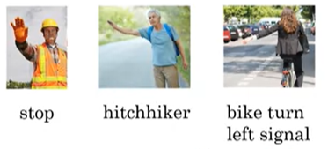
AI Can’t Do (as of) TODAY!
Generating Complex reports with cause and effect
Understand meaning of Image / Language / Audio / text
Distinguish between Very Similar Inputs
Human Values
Common sense

Slide 13
What is Limiting AI / ML / DL ?
Data
Fast Degrading Data
Data Drift
Concept Drift
Purposeful Garbage Data
Data Sources
Reliance on Single source
Basically It’s a DUMB machine!!

